Slide 1
Electric vehicles and their potential for the 9th Edition Outlook
Finbar Maunsell, Assistant Researcher, Asia Pacific Energy Research Centre (APERC) June 2023

Slide 2
EV positives and risks - a quick summary of my general assumptions
Positives
Possible ~70% energy intensity improvement for ~60% of transport use (most cars & urban freight)
10-100% emissions intensity improvement (scaling over time). Probably average 30% improvement currently.
No exhaust fumes
Significantly lower total cost of ownership
Energy security benefits
Fossil fuel subsidies avoided - SEA
New industry to develop – SEA/Chile/China
Likely energy storage use case. Decreases peak load.
Risks
Battery and resource shortages during next 10 years likely
China owns majority of battery and resource market share. Plus growing exports of EV’s. Risk of monopoly and economic insecurity.
Charger and transmission investment costs. At risk from bad planning
Slightly higher upfront cost (for next few years, soon will reach price parity on upfront cost)
Probably not an issue:
Relatively new technology -Battery safety (Insurance issues, disposal) -How do they compare to an ICE in long term use
Environmental effects of mining (consider environment effects of alternative mining/extraction)
Notes:
energy storage use case:
Complements home solar installations
Can flatten load curves

Slide 3
This presentation:
General info about BEV’s
Energy and emissions intensity
Alternatives
Current projections
China
What we can understand about EV’s from China’s progress
USA
What are they doing?
Price parity expectations for longer range cars/trucks
Potential issues for everyone
Mining
Charging
Other vehicle types

Slide 4
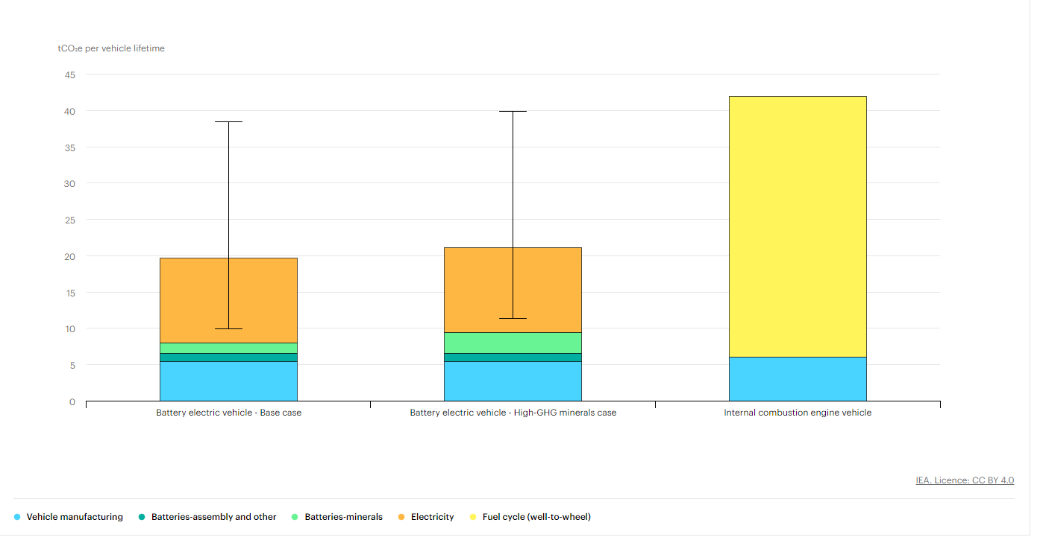
An in-depth look at the IEA’s lifecycle emissions analysis
Notes
The “High-GHG minerals” case assumes double the GHG emission intensity for battery minerals (70 kgCO2-eq/kWh compared to 35 kgCO2-eq/kWh in the base case; other assumptions are the same).
This is the most complex part in this graph because they showed it in kgCO2-eq/kWh.
Still, it’s effect is inconsequential.
The values are for a vehicle manufactured from today’s manufacturing lines.
Perhaps it would be useful to see a range for the emissions intensity of this.
Electricity carbon intensity is based on the IEA Sustainable development scenario for the vehicle’s lifetime (200,000 km lifetime mileage)
The ranges shown for BEV represent cases for charging with a static low-carbon (50 gCO2-eq/kWh) and high-carbon electricity mix (800 gCO2-eq/kWh).
Avg carbon intensity in the world is 450, and the highest in APEC is 685 (Hong Kong)
Note that this is for ‘mid sized’ vehicles. How would you expect a large SUV’s emissions to change by drive type?
Sources
IEA analysis based on IEA (2020c); Kelly et al. (2020); Argonne National Laboratory (2020)
https://www.iea.org/data-and-statistics/charts/comparative-life-cycle-greenhouse-gas-emissions-of-a-mid-size-bev-and-ice-vehicle

Slide 5
An in-depth look at the IEA’s lifecycle emissions analysis
Notes
The “High-GHG minerals” case assumes double the GHG emission intensity for battery minerals
It’s effect is inconsequential.
The values are for a vehicle manufactured from today’s manufacturing lines.
Electricity carbon intensity is based on the IEA Sustainable development scenario for the vehicle’s lifetime (200,000 km lifetime mileage)
The ranges shown for BEV represent cases for charging with a static low-carbon (50 gCO2-eq/kWh) and high-carbon electricity mix (800 gCO2-eq/kWh).
Avg carbon intensity in the world is 450, and the highest in APEC is 685 (Hong Kong)
Note that this is for ‘mid sized’ vehicles. How would you expect a large SUV’s emissions to change by drive type?
So basically, EV’s are expected to have lower emissions intensity (50% on avg), no matter the electricity mix. And over time we can expect the emissons intensity to improve.
Sources
IEA analysis based on IEA (2020c); Kelly et al. (2020); Argonne National Laboratory (2020)
https://www.iea.org/data-and-statistics/charts/comparative-life-cycle-greenhouse-gas-emissions-of-a-mid-size-bev-and-ice-vehicle
Notes:
could show the aperc economies on that line! E.g. find the gco2/kwh of each economy and plot it between the max and min ranges

Slide 6
An in-depth look at the IEA’s lifecycle emissions analysis
Notes
The “High-GHG minerals” case shows that Mining and production of batteries effect is inconsequential.
HKC has the highest emissions intensity (of generation) in APEC
So basically, EV’s are expected to have lower emissions intensity (50% on avg), no matter the electricity mix. And over time we can expect the emissons intensity to improve.
HKC
Sources
IEA analysis based on IEA (2020c); Kelly et al. (2020); Argonne National Laboratory (2020)
https://www.iea.org/data-and-statistics/charts/comparative-life-cycle-greenhouse-gas-emissions-of-a-mid-size-bev-and-ice-vehicle
Notes:
could show the aperc economies on that line! E.g. find the gco2/kwh of each economy and plot it between the max and min ranges

Slide 7
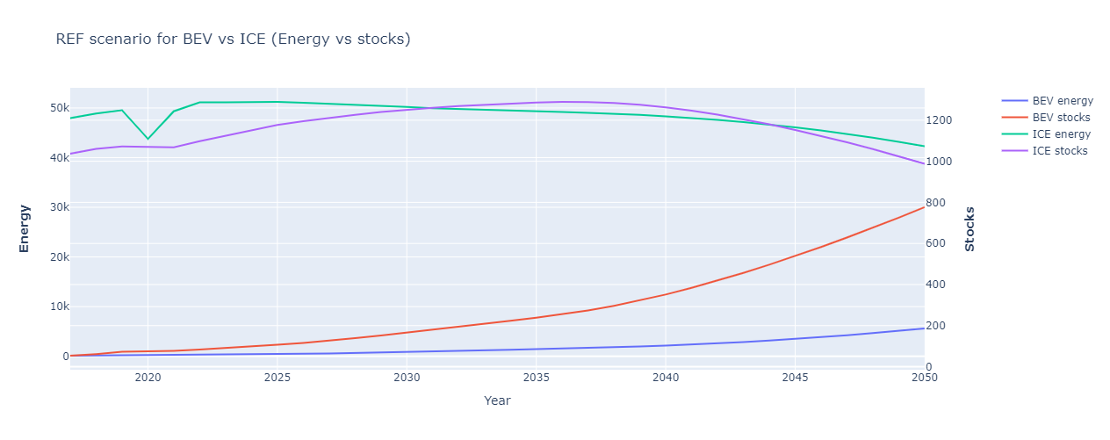
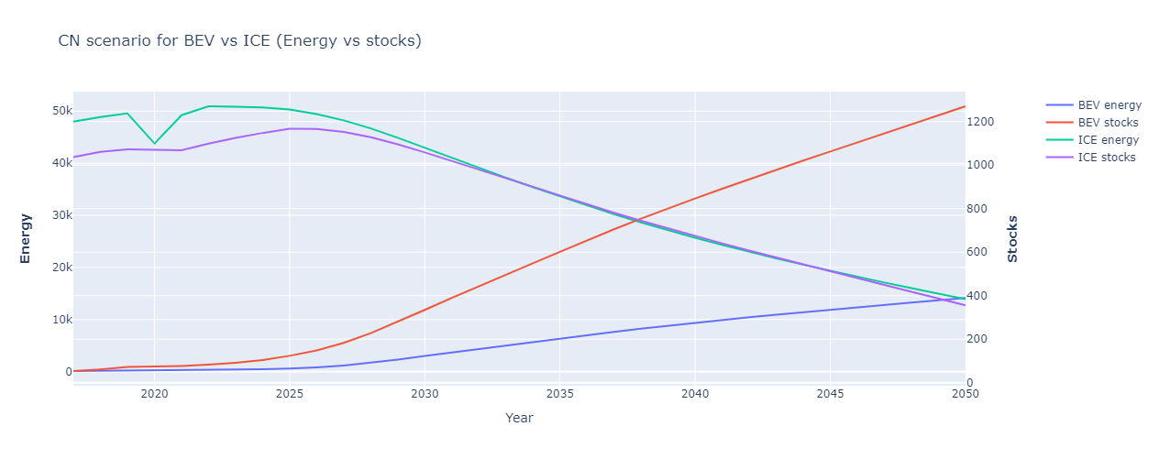
Electric Vehicles introduction
These are our forecasts for passenger EV stocks and their resulting effects on energy use.
Efficiency: See how slowly BEV energy use changes compared to stocks.
They are 3 times more efficient.
Other types of EV vehicles are expected to be used for niche cases (e.g. hybrids for rural households). But they were insignificant in our forecasts.

Slide 8
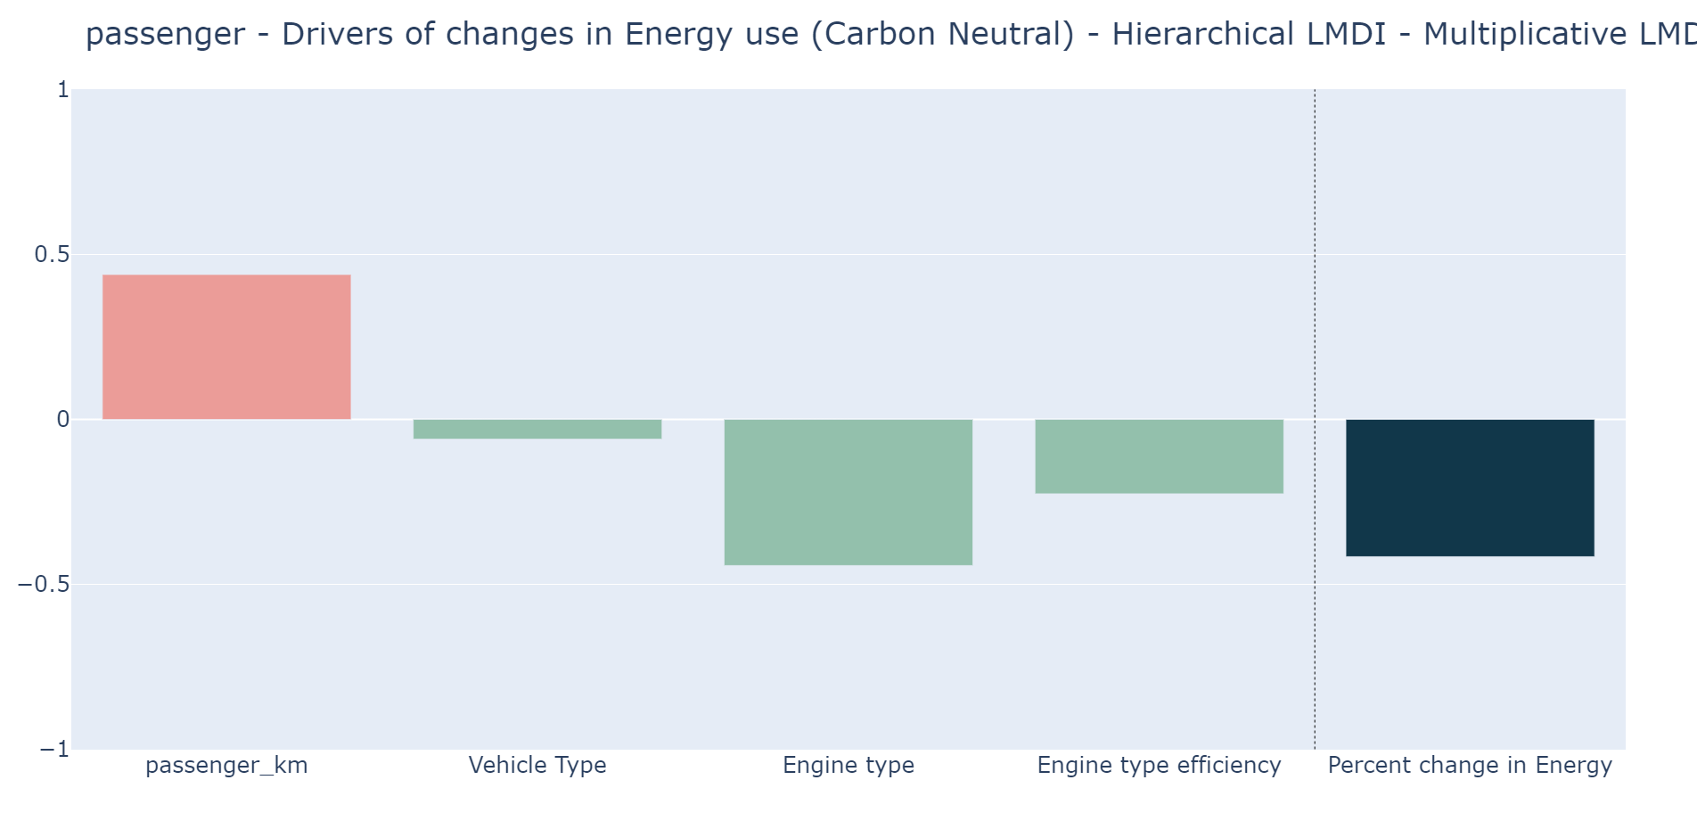
Quantifying energy efficiency effects of EV uptake on energy use
Graphs show drivers of changes in energy use*
Passenger_km = km travelled * occupancy
Vehicle type = different modes of transport (e.g. shifting to rail, bus etc.)
Engine type = effect of changing ICE to EV’s
Engine type efficiency = inherent effect of improvements to engine efficiency (after considering effect of changing engine type)
This slide uses the hierarchical LMDI method.

Slide 9
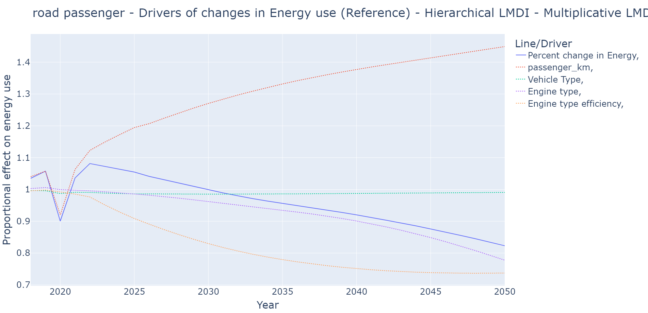
A short-term alternative, ICE efficiency improvements:
Historical worldwide efficiency improvement rate has been an average of 1.5% but is expected to slow (marginal cost increasing)
Very viable short-term solution if current stocks are old
See how engine type efficiency effect slows and engine type effect increases over time.

Slide 10
Biofuels
For cars, unless a country has cheap access, might increase fuel price (e.g. NZ scrapped its biofuel mandate)
Allows for decarbonization of heavy transport (including aviation) which is an issue for electricity (related to energy to weight ratio)
Simple, e.g. ethanol, 70% of energy per volume as gasoline
Advanced, e.g. butanol, 100% energy per vol.
“Advanced vs simple biofuels” = mixing vs pure
Advanced biofuels: don’t need to be blended with petrol/diesel because they yield about the same amount of energy per volume. Necessary for aviation.
Important to consider lifecycle sustainability (food vs fuel, deforestation etc.)

Slide 11
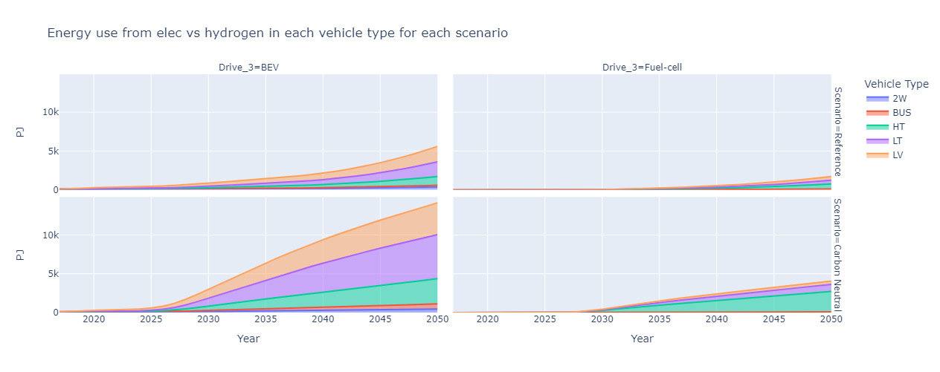
Hydrogen
Currently: expensive capital costs and relatively expensive to produce
For transport, very similar use cases to biofuels.
Similar energy to weight ratio of oil and advanced biofuels
8th edition had max 4,000PJ used in CN in 2050. This is about 1/10th of transport energy use. Same amount as Industry
Hydrogen aviation is not included in the graph above

Slide 12

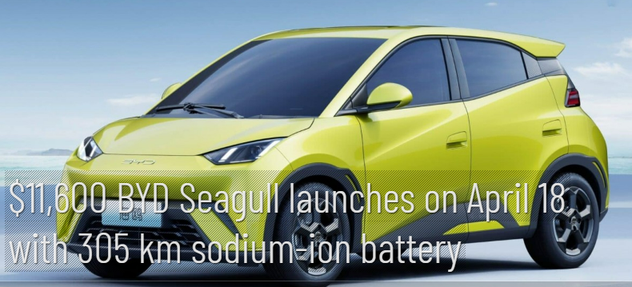
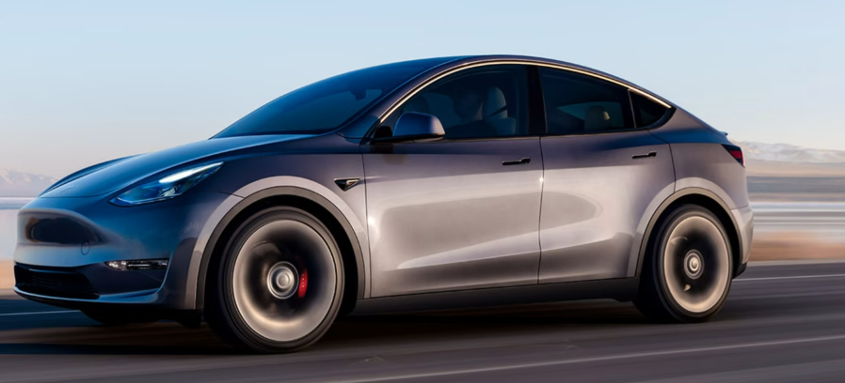
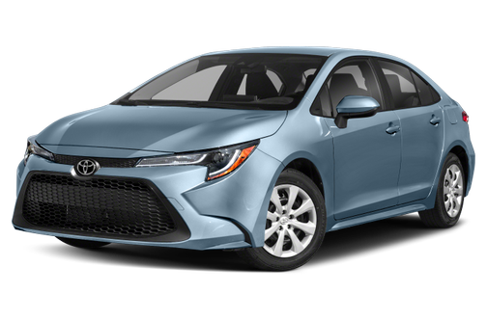
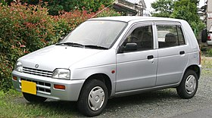

Let’s go shopping for cars:
Model | Price | Range | Features
Wuling Mini EV | $5,000 | 120km (74miles) | Cheapest on market
BYD Seagull | $11,600 | 305km (189miles) | Expected to be best selling EV in China in 6 months (cheap because of sodium ion battery)
Tesla Model Y | $50,000 | 482km (300miles) | Cool – best selling EV
Toyota Corolla | $21,700 | 743km (461miles) | Most popular ICE - boring
Suzuki Alto | $6000 | 770km (478miles) | Wuling Mini competitor - kawaii
BMW X3 | $50,000 | 581km (360miles) | Tesla competitor

Slide 13
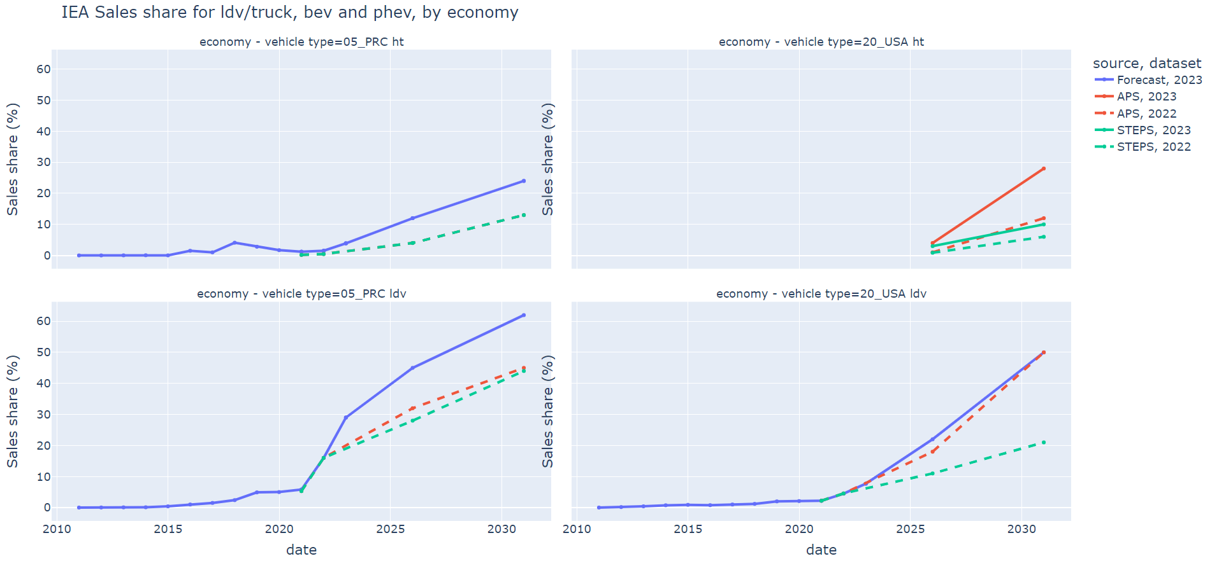
The last years news seem to have influenced IEA to increase their expectations for the USA and China.
Generally, the IEA’s forecasts match our 8th Edition reference case, but our CN was quite aspirational.

Slide 14
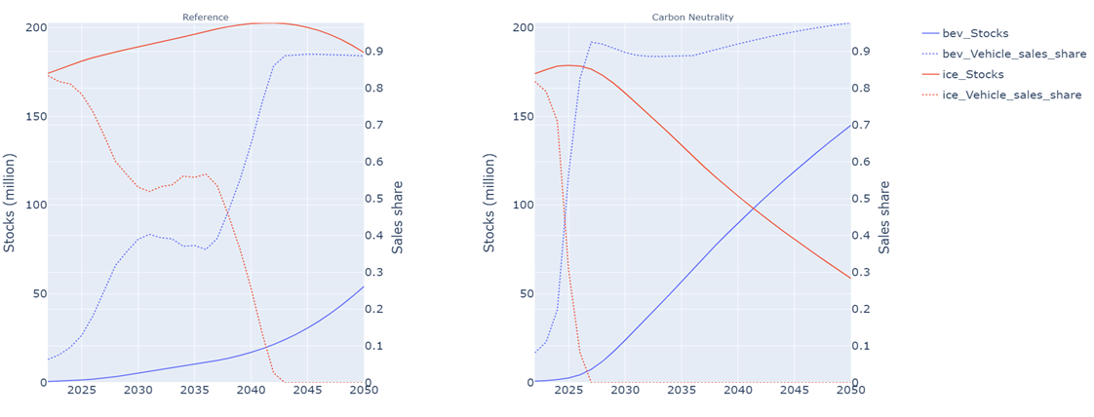
Vehicle sales shares for EV’s vs ICE’s in light vehicles
Please observe the relationship between sales share (dashed) and stocks (solid)
Note that this is for the whole of APERC

Slide 15
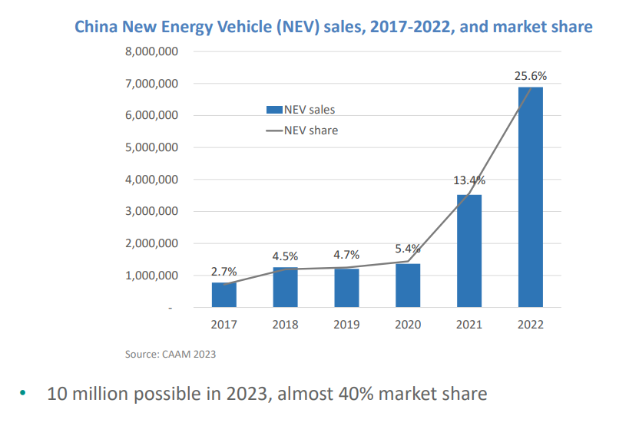
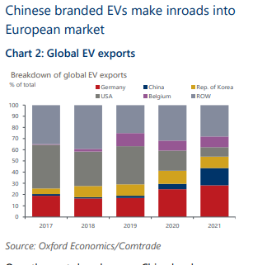
China’s EVs push
In 2007 China invested over RMB2 billion (US$300 million) in new energy vehicle development.
Estimated 100billion dollars spent by Chinese govt since 2009 (according to podcast by economist)
Now they already have a high EV sales share (10 million possible in 2023, almost 40% sales share)
China are now ahead of their EV targets
Consumer surveys show: EV’s have become more desirable than ICE’s
The largest producer of EVs (> 50%)
Export market beginning to grow:
>10% of EV’s now
Great presentation/podcast about this from which most of this info (and graphs) are from: https://www.oxfordenergy.org/publications/an-update-on-chinas-ev-revolution/
https://www.oxfordeconomics.com/wp-content/uploads/2023/03/China-drives-its-way-up-EV-exporter-rankings.pdf

Slide 16
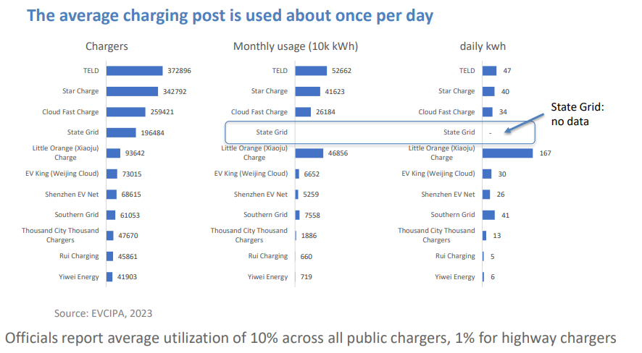
China EVs - public charging:
Good news:
Likely that large fraction of drivers use public charging regularly
(December consumption represents 140 kWh per vehicle, sufficient for 1000 km – avg. yearly km is ~20,000 to 15,000km)
Risk:
Low utilization rate for public chargers ->
Maintenance and operation issues result
Highway chargers are only used in public holidays
Great presentation/podcast about this from which most of this info (and graphs) are from: https://www.oxfordenergy.org/publications/an-update-on-chinas-ev-revolution/

Slide 17
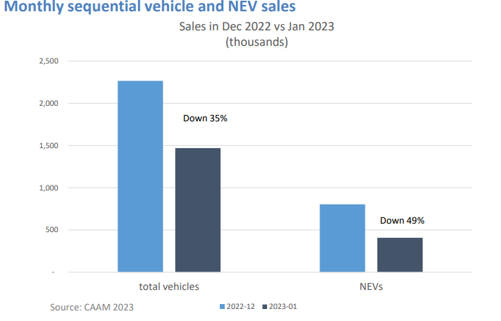
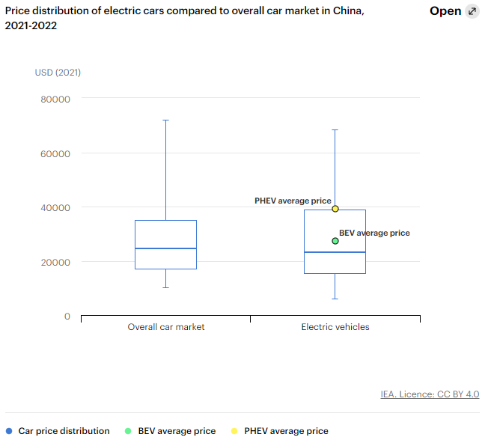
China EVs subsidies dropped, is this price parity?
Subsidies dropped in 2023 -> drop in EV sales (on top of CNY effect)
But sales still high
Dropping subsidies implies that EVs are at/near cost parity
Probably will start exporting soon too.
Will price continue to fall?
- Looming battery scarcity issues
- Global economic fragility
+ Technological learning curves
= Long term likely, short term maybe

Slide 18


USA EV’s – an overview
Biggest cars with longest range requirements
As things stand, security is not impacted as beneficially, unless production and resource extraction is kept onshore/within alliances.
America needs to stimulate this production/extraction, or it will be difficult to transition to EV’s without compromising energy security
Need to build out charging.

Slide 19
Inflation Reduction Act (IRA) and the Bipartisan Infrastructure Law (BIL)
IRA estimates:
Large incentive (expected average of $6.45k per vehicle) to EV’s.
~$5,000 tax credit to consumers for purchasing qualified EVs ($7.5B)
~$1,450 average battery production tax credit (also affect battery production for other uses) ($2B)
BIL estimates:
Also consider Bipartisan Infrastructure Law from Nov 2021:
$7.5billion to deploy a national network of 500,000 electric vehicle chargers (as much as is spent on consumer tax credit!)
More than $7 billion to ensure domestic manufacturers have the critical minerals and other components necessary to make EV batteries
To put these big numbers into perspective:
7.5 + 2 + 7.5 + 7 = $24B
That is, 8 cents per person, 6% of the IRA total, 0.4% of federal government spending for 2022, and 0.1% of total GDP.
This will help the US transition it’s automotive industry and stimulate demand for the new production of EV’s. It will be interesting to see the results
We have already seen $52 billion in post-IRA investments into North American EV supply chains.
Values from https://theicct.org/wp-content/uploads/2023/01/ira-impact-evs-us-jan23-2.pdf and https://decarbonization.visualcapitalist.com/breaking-down-clean-energy-funding-in-the-inflation-reduction-act/

Slide 20
Health costs from air pollution
https://www.hsph.harvard.edu/c-change/news/trechsources/
Ozone and fine particulate matter from vehicle emissions in 2016 led to an estimated 7,100 deaths in the Northeast and Mid-Atlantic regions of the U.S
Region wide, light-duty trucks, which include SUVs, were responsible for the largest number of premature deaths at 2,463 followed by light-duty passenger vehicles (1,881) and heavy-duty trucks (1,465)
New York, Pennsylvania, and New Jersey were hardest hit with health damages at $21 billion, $13 billion, and $12 billion, respectively, in 2016 (the most recent data available from EPA).
On a ton for ton basis, buses in the New York-Newark-Jersey City metropolitan area had the largest health damages at $4 million for every ton of particulate matter emitted.

Slide 21
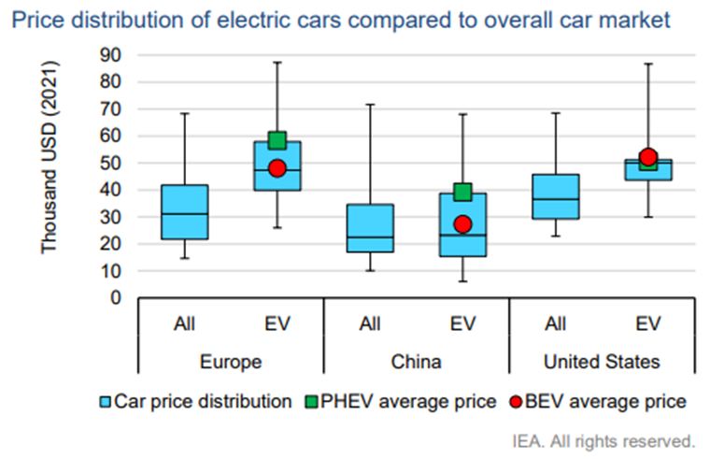
USA EVs – will the sales share of EVs increase?
As of 2022, USA BEVs are ~US$15,000 more expensive on average.
Whereas Chinese BEVs are near price parity
US uses bigger cars with more range
~US$6,500 avg IRA incentive for a BEV from now until 2030. Speeds up the progress to price parity
From IEA EV vehicle outlook

Slide 22
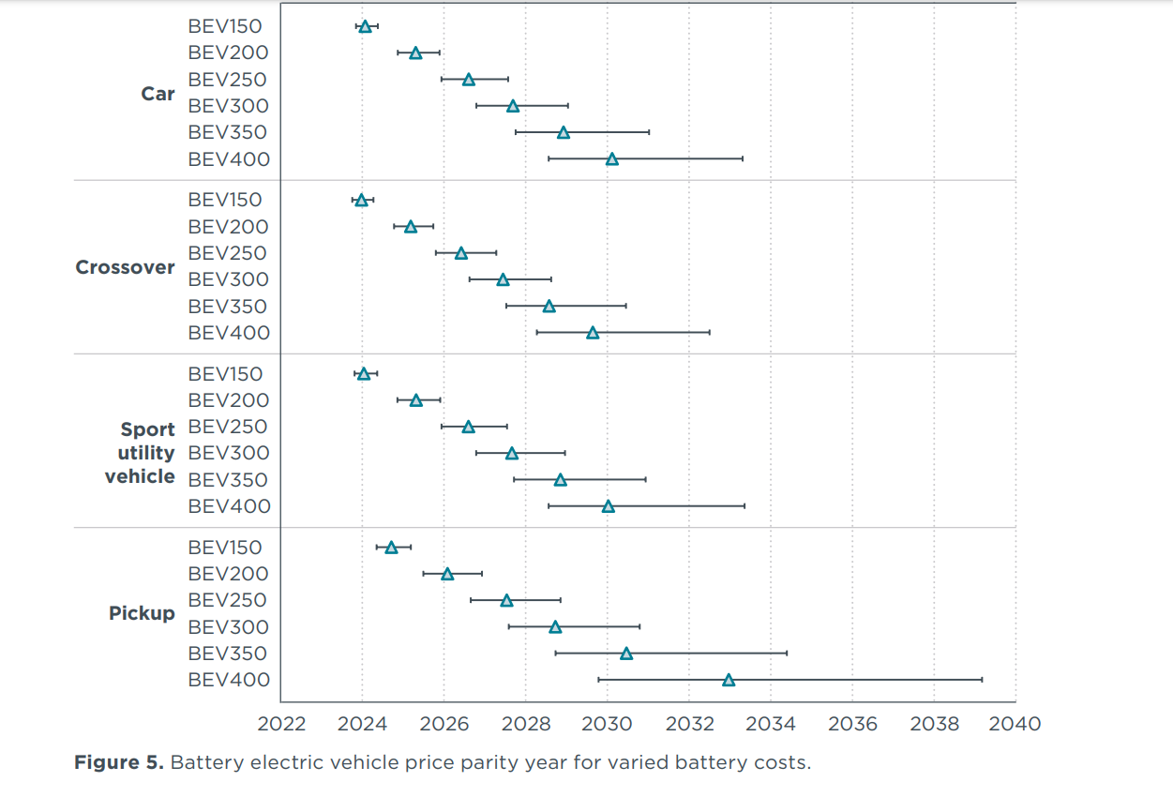
Price parity expectations
BEV300 refers to 300miles per charge. Generally, you should fill your EV to 90%, so that’s ~4-6 hours on highways.
300miles is the expected average for USA
Expectation: 2027-2028 for price parity for 300mile range vehicles
This doesn’t include 6.5k subsidy for IRA!
This graph suggests that range is the most important factor for when a BEV will achieve price parity. All car weights have similar price parity expectations.
https://theicct.org/wp-content/uploads/2022/10/ev-cost-benefits-2035-oct22.pdf
Notes:
Current avg is like 220miles per charge

Slide 23
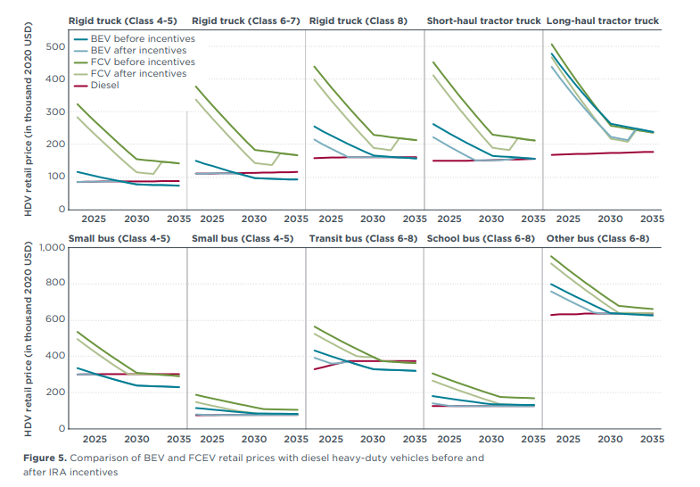
USA truck price parity expectations
Summarised:
Urban and short haul truck classes (Delivery trucks, buses, dumptrucks, single trailer trucks) expected to reach price parity by end of decade (2028-2030)
Long haul trucks unlikely to reach price parity until 2040+, but this is 'upfront cost'.
Research shows upfront cost could be higher for diesel
Fuel cell vehicles upfront cost will be an issue for a long time.

Slide 24
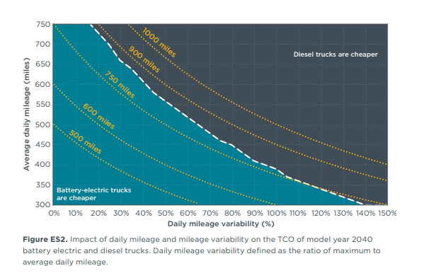
Quick analysis of TCO for (big) trucks
Trucks for ~750 miles or less are cheaper in 2040 (most truck drivers average around 605 to 650 miles per working day)
Would be interesting to know what the graph is like for 2035.
But probably, EV trucks can work, they will just take longer to arrive because of the high range requirement
https://theicct.org/wp-content/uploads/2023/04/tco-alt-powertrain-long-haul-trucks-us-apr23.pdf

Slide 25
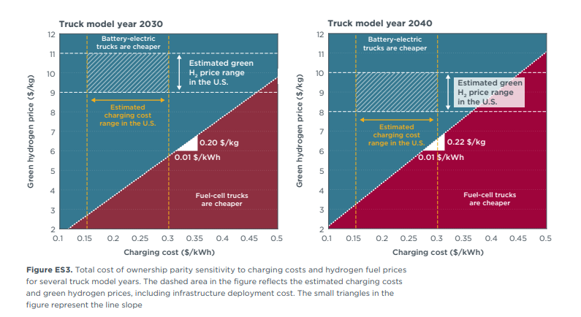
Manuels expectations for hydrogen price.
Expect that most of cost comes from transportation. Niche cases will probably be cheaper where cost of electricity transmission is high (eg. Peruvian Jungle)

Slide 26
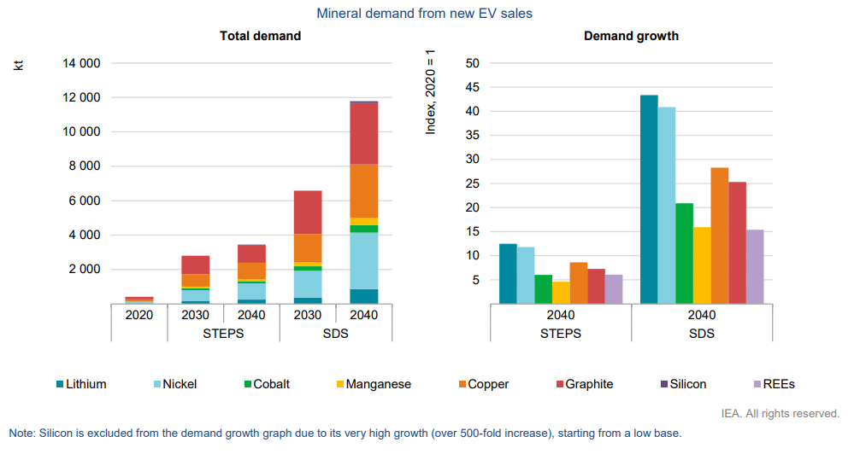
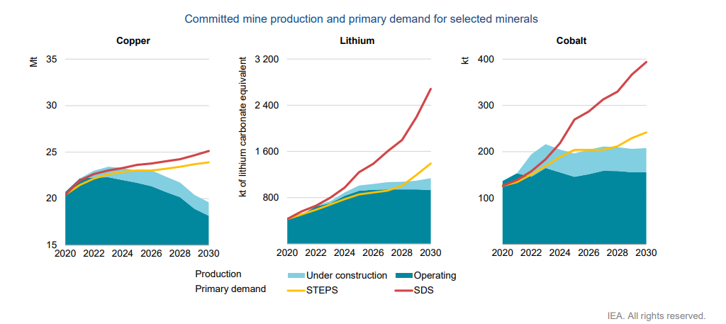
Impending storm: Resource extraction and refining
EVs use around six times more minerals than conventional vehicles. These are also harder to extract and refine.
For mines, global average lead times from discovery to production are about 17 years
There are security of supply concerns for everyone except China:
China controls 80% of rare earth materials with new SOE
50% or more of copper refining with comparable shares for other metals;
~70-80% or more of large format battery manufacturing capacity
All figures based on world totals. From IEA: The Role of Critical Minerals in Clean Energy Transitions

Slide 27
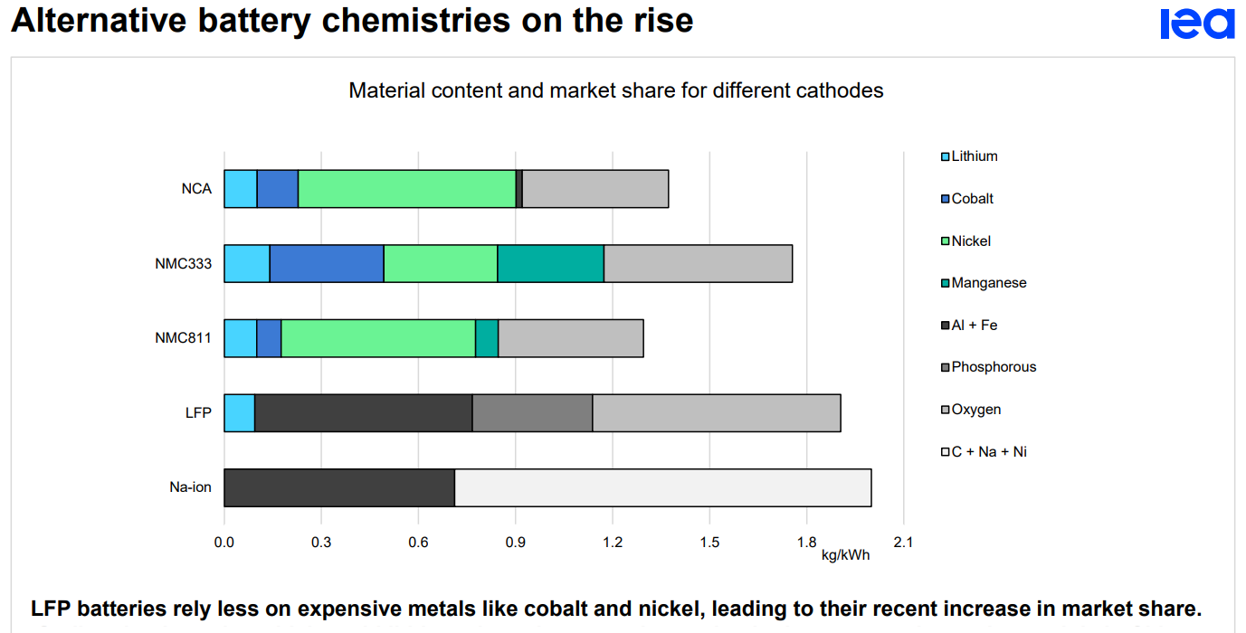
Cheaper battery chemistries could alleviate raw material concerns?
Share in 2022:
NCA – 10%
NMC333 – 5%
NMC811 – 15%
LFP – 25%
NA-ion – 0.5%
Notes: Na-ion = Sodium ion; LFP = Lithium iron phosphate; NMC = Lithium nickel manganese cobalt oxide; NCA = Lithium nickel cobalt aluminium oxide.

Slide 28
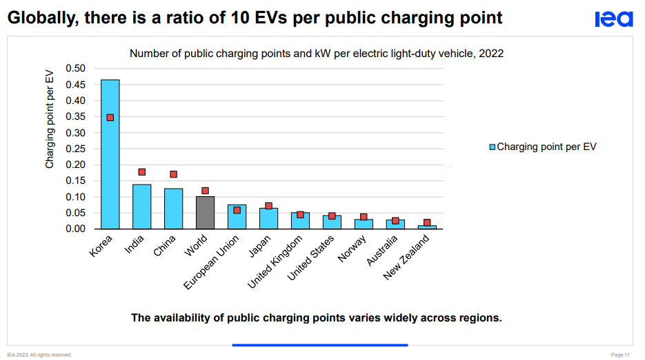
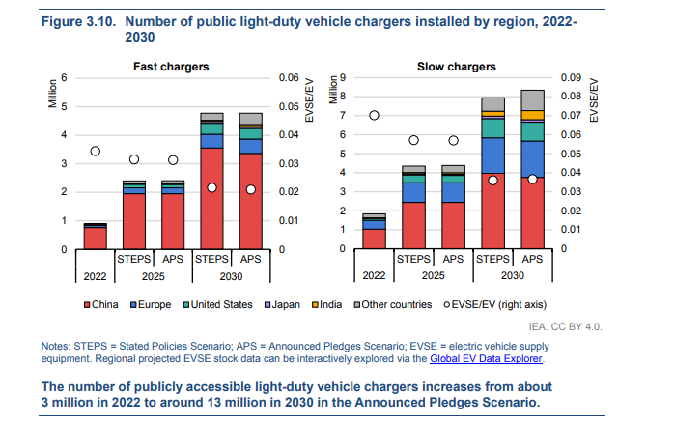
Charging
Number of public chargers depends on ability for owners to charge at home.
USA needs less than China.
Faster chargers mean more cars charged, so less chargers needed (red square is the kw equivalent)
Korea has relatively slow chargers.
Would be interesting to quantify transmission costs. How much does it add to the total cost? Are governments including this in their planning?
Another hurdle for electrifying trucks is the cost of public charging because it needs higher power transmission capacity.

Slide 29
Charging costs quantified
Economy | Cost | Number of chargers (all by 2030) | Programme | Comment
USA | USD5billion | 500 000 | National Electric Vehicle Infrastructure (NEVI) through BIL (bipartisan infrastructure law) | ($10,000 per charger)
USA | 800,000*$10,000 = $20 billion? <- probably too high? (800,000 is number of remaining chargers, 10,000 is $100,000/10) | NAN : Tax credit (<=30% per charger up to $100,000) | IRA (inflation reduction act) | Number of chargers expected to reach over 1.3 million in 2030. In 2030, there are expected to be about 30 electric LDVs per charging point. (IEA)
UK | USD2.1billion | 300,000 | ? | 7000 per charger
Canada | USD 385 million | 84,500 | Canada Infrastructure Bank | 5000 per charger
AUS | Ausd 39.3million | 117 | National EV charging network $39.3 million to help deliver 117 EV chargers on key highway routes across Australia | Aus 330 thousand per charger

Slide 30
Indonesian case study – an EV hub?
Indonesia is currently the second-largest automotive producer in the Southeast Asian region, behind only Thailand, with 900,000 passenger vehicles produced in 2021.
They are planning (and have the ability) to become a major player in the global EV market:
Indonesian nickel export ban (2020):
Makes battery production within the economy attractive, which is intended to stimulate an EV manufacturing industry
In 2022 Indonesia became the 2nd largest producer of cobalt
March 2023: introduced subsidies for domestic EV production.
Domestically produced EV’s probably won’t be exported.
They are also exploring policy to encourage swappable batteries between bikes from different producers and battery-as-a-service (BaaS) business model
Other SEA economys (Thailand, Vietnam, Malaysia) are also encouraging domestic production

Slide 31
2W progress
In SEA:
High amount of 2W (about 12.5% of total energy use, compared to <1% in most other economies)
Low cost of ownership
More suited to the cities and traffic
Batteries are the major cost
IEA analysis on the TCO (total cost of ownership) in India suggests that electric three-wheelers are already 70% cheaper than their gasoline-power ICE equivalents over their lifetime (IEA, forthcoming)*
Innovative demand incentives seen in India:
battery-as-a-service (BaaS) business model
Decreases upfront cost (important since TCO is 70% cheaper)
draft battery swapping policy
Decreases range anxiety and charging time
https://www.iea.org/reports/global-ev-outlook-2023/trends-in-electric-light-duty-vehicles

Slide 32
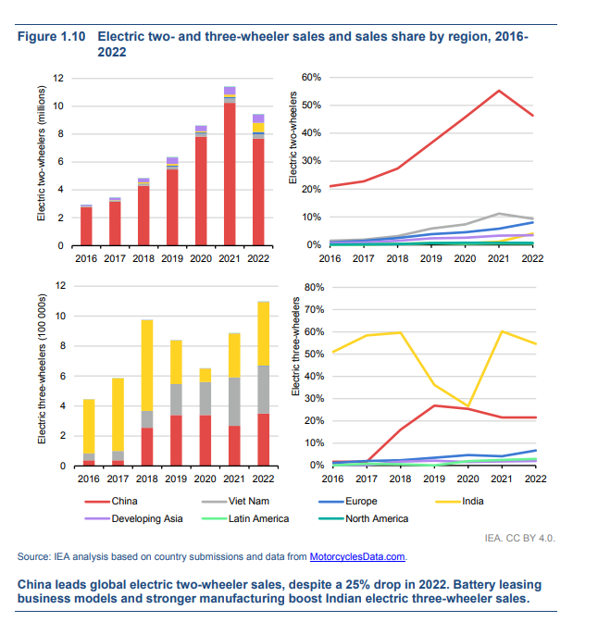

Slide 33
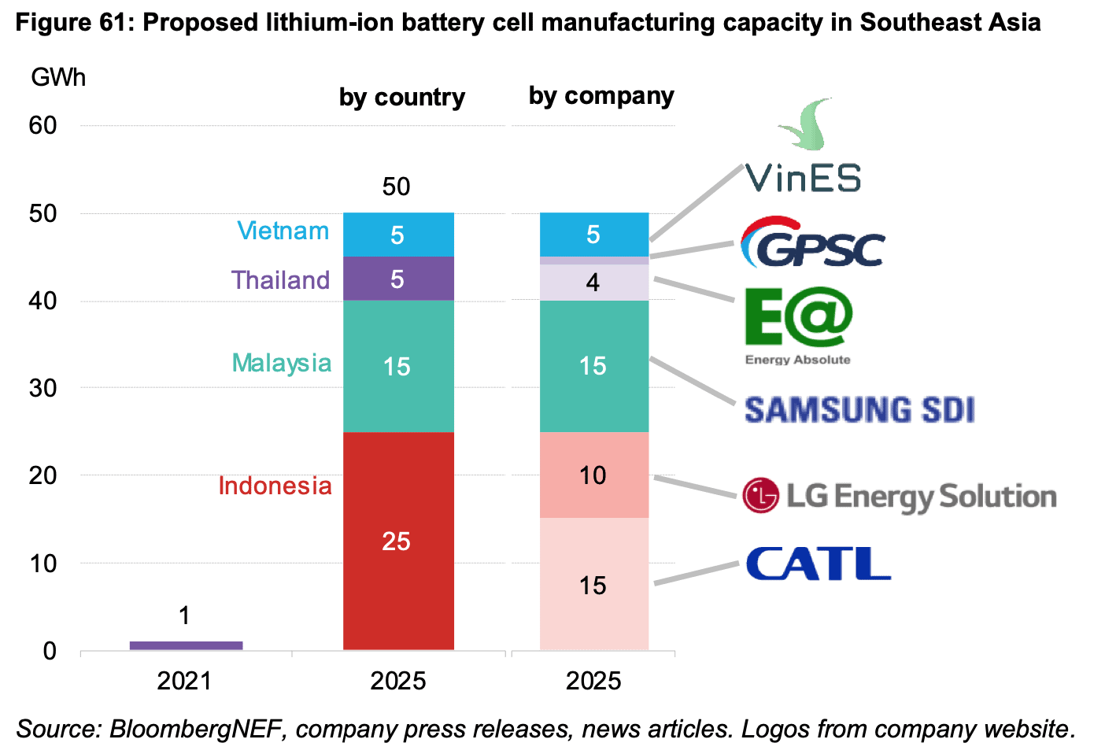
2022 worldwide EV battery manufacturing capacity is about 550GWh and was 330GWh in 2021. In 2025, it will probably be around 1500GWh.

Slide 34
Fossil fuel subsidies
Started off to keep price stable.
Now ‘addictive’ politically
Analysis shows they now are too expensive.
Will get more expensive as growth persists
Fossil fuel subsidies decrease demand for EV’s.
Increased demand for EV’s decreases money spent on subsidies.

Slide 35
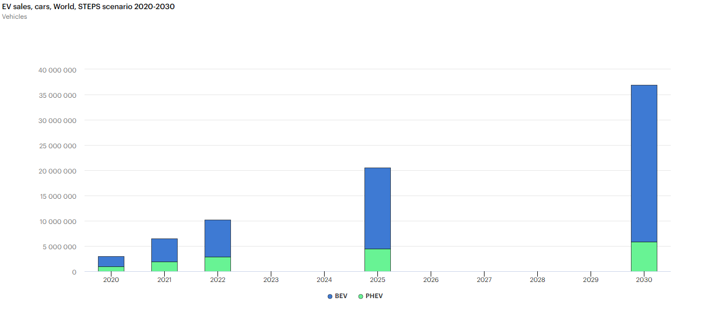
PHEV’s
My opinion based on recent trends: As BEV’s become cheaper at greater ranges, the benefits of PHEVs (range) will become less important.
BEV’s will become cheaper than them in almost all classes
Economies should continue to treat them as EV’s, as they still have positive effects on emissions and energy efficiency.
On their efficiency:
Real-world data shows that U.S. drivers use 50% more on gasoline and 30% less on electricity than shown in EPA’s fuel economy labels.
PHEV’s are probably not as efficient as you expect.
Notes:
https://theicct.org/wp-content/uploads/2022/12/real-world-phev-us-dec22.pdf
https://www.epa.gov/fueleconomy/plug-hybrid-electric-vehicle-learn-more-about-new-label

Slide 36
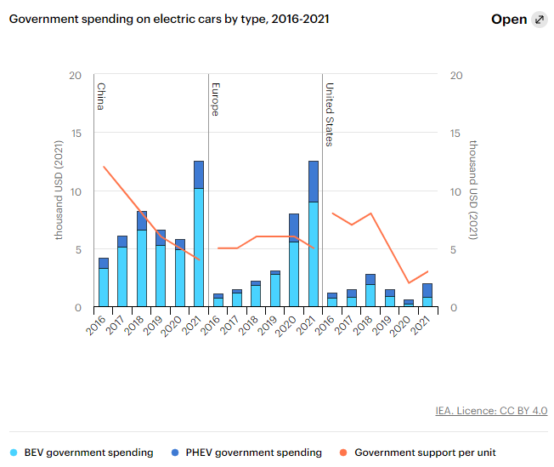
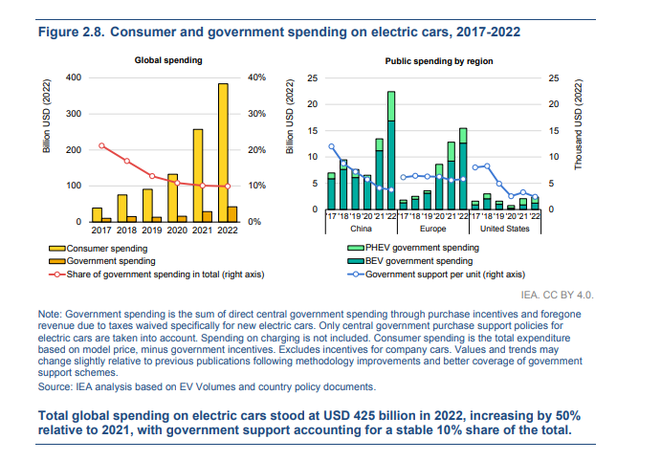
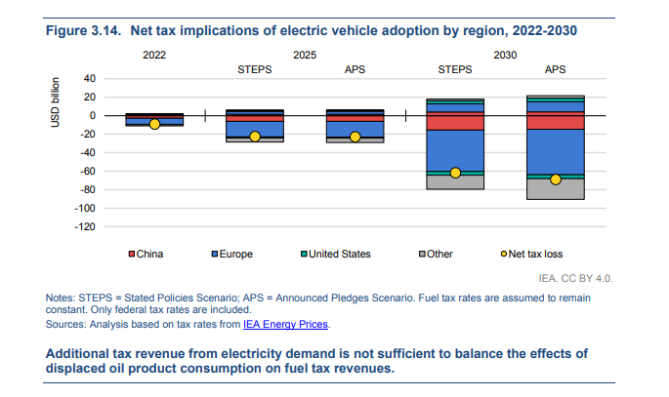
How expensive is it all for governments?
Notes:
https://en.wikipedia.org/wiki/Government_incentives_for_plug-in_electric_vehicles

Slide 37
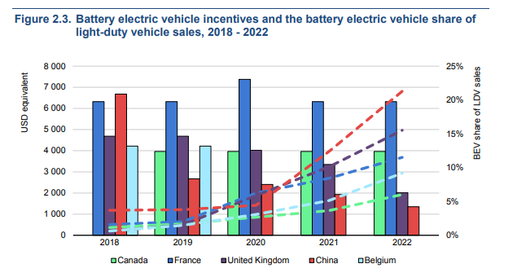
China, the United Kingdom, and Belgium have all reduced and/or ended private passenger car subsidy schemes and still see shares continue to grow. Canada and France have maintained subsidies to encourage further adoption

Slide 38
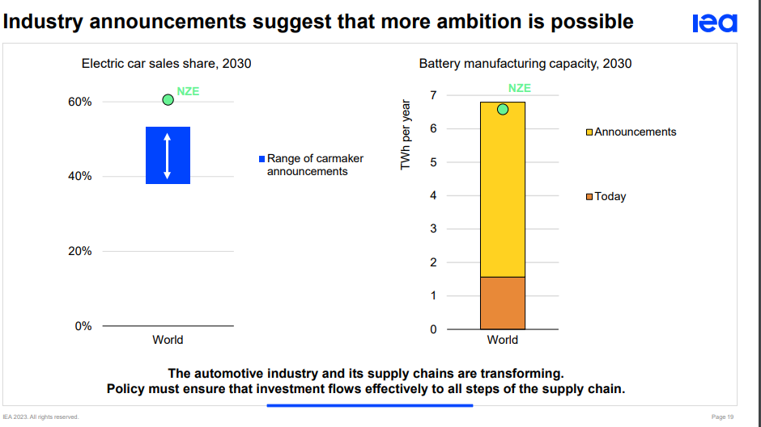

Slide 39
Wrap-up
EV’s are a great opportunity and can have positive impacts on all aspects of the energy trilemma
However, they do have some issues:
Resource extraction / refining
Non-China production ramp-up required to improve security
Charging investments required
Price parity is still a few years away… and what happens if cost of raw materials increases?
China is already on the ‘road’ to success
USA has now made their investments, now we need to see if it is enough
SEA are showing a lot of interest in production. They have a lot to gain from improving vehicle efficiency and avoiding fuel subsidies. Keep an eye out for investments and new policies

